Slide 1
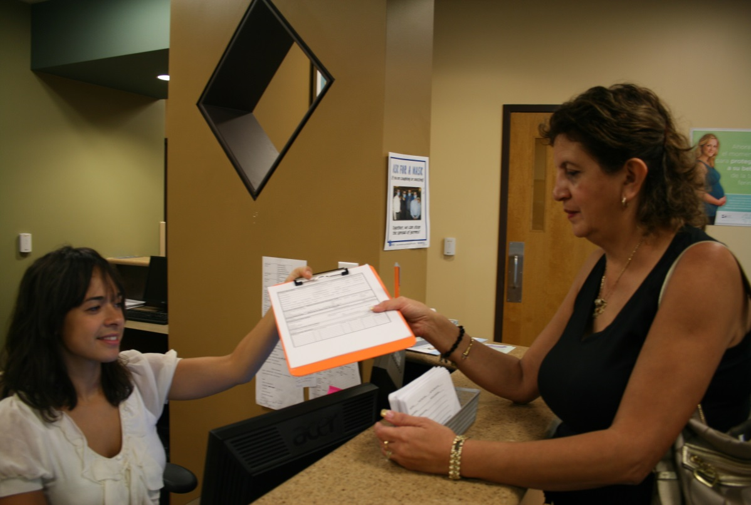
Strategies for Effective Patient Registration & Outreach
© NCFH 2018
Notes:
This module will cover important strategies to keep in mind when communicating with patients through the health center encounter, from outreach and patient registration to the delivery of health information.
Key points:
As you know, a lot of information is provided to patients at every point of contact when accessing care.
The patient registration process, especially for first time patients can be overwhelming and confusing.
This module will cover key strategies to keep in mind when communicating with the patient about the registration process and conducting outreach services.

Slide 2
Learning Objectives
Understand the importance of improving the patient registration process through effective communications.
Gain an understanding of various strategies to improve communications.
Increase knowledge in assessing patients’ communications needs
Improve methods of verbal and written communication
Understand the importance of cultural competency, communication skills and customer service.
© NCFH 2018
Notes:
Review learning objectives.

Slide 3
Outline
This lesson includes the following:
Important considerations in the patient registration process
General tips and strategies to include:
Create a shame free environment
Use universal precautions
Assess patients’ communication needs
Practice effective communication skills
Be aware of cultural diversity
Empower, involve and educate Patients
© NCFH 2018
Notes:
Review module outline.
Developed by the National Center for Farmworker Health, Inc. © 2013

Slide 4
Why is this Important?
Shifts and changes in populations
being served
Patients have varied needs
Patient Registration Questions can be overwhelming
New approaches are needed in service delivery
Providing culturally competent care is essential
Customer Service is the key!
© NCFH 2018
Notes:
Read or share.
Key points:
We know our communities are diverse and changing.
Shifts in ethnic diversity are not just about numbers, but also the impact of cultural differences. Patients will have different needs.
It is important to remember that the patients you serve all come from different backgrounds, therefore, it is key that we be open to learning about who they are so we can provide the best customer service and care possible.
We need to practice effective communication skills so patients feel they are understood and feel comfortable in asking questions.
New approaches are needed in service delivery to address language, literacy and cultural differences among patients.
The health care climate is changing. Health centers are experiencing rapid growth, communities are changing, there are changes due to ACA. More patients will now have health care and will have choices on where to receive care. At all levels in our health center, at every point of contact, we want to ensure we are providing the best care possible because we want to retain our patients. The first point of contact for our patients is the front desk. Or the first point of contact may have been the outreach worker. First impressions are key and sets the tone for the rest of the patient encounter.
Developed by the National Center for Farmworker Health, Inc. © 2013

Slide 5
Important Considerations in the Patient Registration Process
How do I ask the questions?
What if the patient is reluctant to answer
the questions?
What if I know they are an agricultural worker and they
but do not confirm or identify as such?
What if the patient is having difficulty filling out the form? What assistance can I offer?
How can I create a safe, comfortable and respectful environment?
© NCFH 2018
Notes:
Read or share.
Key points:
We know it can be difficult to ask patients so many questions as part of the registration process.
Not only can it be overwhelming, but we find that many times the patients do not understand why all the information being collected is needed.
As we discussed in previous modules, having to confirm a patient’s special population designation status, (in this case Agriculturel Workers), there are additional questions that need to be asked.
Many health centers experience challenges in trying to gather this additional information from their patients. So, we are not alone.
In this section of the training, we will be discussing these important considerations in the patient registration process and we can braisntorm on other tips and strategies that will help us to better gather this information.
Developed by the National Center for Farmworker Health, Inc. © 2013

Slide 6
How Do I Ask the Questions?
Use the right language and easiest terminology.
Examples:
Have you or a family member worked in any type of agriculture in the past 2 years?
Have you or a family member worked in the fields in the past 2 years?
Have you or a family member worked on a farm in the past 2 years?
What type of work do you do?...Then probe.
Do you work in agriculture, like in crops, animal farms, etc?
Use images/pictures to illustrate farms, types of crops, tasks, etc.
© NCFH 2018
Notes:
Read or share.
How do I ask the questions?
Key points:
One of the first questions you will ask in our registration form is if the patient or member of their family worked in agricuture in the past 2 years? What does agriculture mean to the patient? Does it only mean working in horticulture? What does a migratory or seasonal worker mean? What is the right way to ask the question?
We need to use the right language and easiest terminology as possible.
How can we ask the questions differently so they do not sound confusing. Do the members of our community use the terms farms, fields, camps? How do they describe the type of work they do?
You can use images/pictures of different agriculural workers and the tasks they do to illustrate the information you are tryng to gather.
It is key that we gather enough information about our local agricultural worker community so staff is informed. For example, what are the most common industries? Who are the ag employers in the community? What are the types of crops we have in our community? Do we have animal farms?
Based on this information, we can tailor our registration forms so they are understandeable to our patients.
Ask the following questions:
What are some of the common terms that are used in the local agriculture community?
What are some suggestions we can make to our registration questions?

Slide 7
What if the patient is reluctant to answer?
Ask the patient the question in another way.
Who do you work for?
What is the name of the company?
What type of work do you do?
Let them know why you need to know this information:
We want to be able to better serve you.
We receive special funds for agricultural workers and we need to keep track of all patients we serve.
We have special programs to assist you.
© NCFH 2018
Notes:
Read or share.
What if the patient is reluctant to answer?
Key points:
As we previously discussed, if we know our local community then we are able to tailor the questions.
We need to be creative in how we can ask the question in another way.
Perhaps, you can ask….what is the name of the company you work for? The response may let you know if they work in a local farm.
It is also important to let the patient know why you need this information. You want them to know you are tyring to better serve them. You can also let them know you recieve special funds to serve the agricutural worker community.
Ask the following question:
What other creative ways can you think of?
Developed by the National Center for Farmworker Health, Inc. © 2013

Slide 8
What if I know the patient is an Agricultural Worker?
If you know they are currently working in agriculture, then register them as such and explain to the patient why.
Explain to the patient why you need to know this information.
Let them know they do not need to be afraid. You provide health care and their information is not being shared with anyone without their permission.
© NCFH 2017
Notes:
Read or share.
What if I know the patient is an agricultural worker?
Key points:
If you know they work in agriculture, you may want to let them know you are aware that they work in a farm, or in a type of industry. Let them know why you need to know this information. Then register them as an agriculutral worker.
Witha more detailed explanation, they may feel more comfortable to answer.
Reiterate that their information will not be shared with anyone outside the heatlh center without their permission.
Ask the following question:
What other helpful strategies can you share?
Developed by the National Center for Farmworker Health, Inc. © 2013

Slide 9
What if the patient is having difficulty filling out the form?
Confirm if they understand the question.
Reiterate questions or say in simpler terms.
Always be mindful of tone of voice.
Offer assistance in filling out form.
Make sure forms are available in
patient’s preferred language
© NCFH 2018
Notes:
Read or share.
What if the patient is having difficulty filling out the forms?
Key points:
It is important to recognize the clues that may indicate that your patient may be struggling. In the next section, we will be discussing general tips and strategies and how to create a shame free environment for our patients.
When you find that someone does need assistance, provide help confidentially. Help them in a private area, not in the waiting room for all to see.
It is important to remember, that not being able to read can cause shame for some patients. Handling this issue as delicately as possible will only help the interaction and will demonstrate respect and care to the patient being served.
Developed by the National Center for Farmworker Health, Inc. © 2013

Slide 10
General Tips and Strategies
© NCFH 2018
Notes:
This section of the module will cover general tips and strategies that should be taken into account when communicating with patients and providing the best care possible.
Developed by the National Center for Farmworker Health, Inc. © 2013

Slide 11
1. Create a shame-free experience
Convey an attitude of helpfulness, caring and respect—by all staff
Ask questions to help patients open up
Listen
Encourage patients to ask questions
SMILE ☺
Provide assistance
confidentially
© NCFH 2018
Notes:
Read or share.
Key points:
Strategy 1. Create a shame-free experience
Convey an attitude of helpfulness, caring and respect that should be done by all staff: First impressions make a big difference!
Ask open ended questions to get patients to open up. What and How questions work well. You might start by asking “How can I help you today?”
Listen. It is so easy to forget this critical piece of clear communication. Giving the patient time to talk about his or her problems or issues is very important.
Encourage patients to speak up and ask questions. Assume that patients will not understand and let them know that what you are talking about is difficult. “Let me know when you have questions”…the ‘when’ gives them the impression that you are expecting them to have questions.
Take responsibility for communication breakdowns. One of the most important things to remember in creating a shame-free experience is to remember it is your job as the front desk staff/ educator/ provider to help the patient understand regardless of why they may have difficulty. “I didn‘t explain that very well…let me try again”.
When you find that someone does need assistance. Provide help confidentially. Help them in a private area, not in the waiting room for all to see.

Slide 12
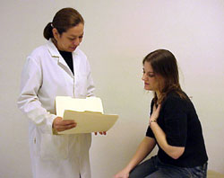
2. Use universal precautions
Assume everyone has difficulty understanding questions and health information
Create a safe and shame-free environment
Offer help to everyone, regardless of appearance
Provide patient-centered care
© NCFH 2018
Notes:
Read or share.
Strategy 2. Use universal precautions
Key points:
Having limited literacy skills is more common in some populations than in others, but many patients have difficulty understanding complex or unfamiliar health information.
This is the recommendation of the National Action Plan to Improve Health Literacy because low health literacy affects so many patients all the time, and all of us at some time.
Health information can be complex and difficult to understand even for those individuals who have more education. On average, people read 3-5 grades lower than the last year of school completed. It is important to strive to use plain language in our communications and when providing written materials, they should be written in a 4th-6th grade reading level.
Create a safe and shame-free environment so patients can feel comfortable in asking you questions.
Offer to help, regardless of appearance.
Always strive to provide patient-centered care.

Slide 13
3. Assess Communication Needs
Recognize Clues/Red flags
Making excuses
Perceived resistance
Has no questions
Frequently missed appointments, tests
Non-adherent with meds or treatment
Just nod their head in understanding/silence during registration process or appt.
Incomplete forms
© NCFH 2018
Notes:
Read or share.
Strategy 3. Assess Communication Needs
Key points:
In the patient registration process, it is important to pick up on a peron’s ability to read or write. If asked, a patient may not tell you. Can you see the patient sturggling with filling out the forms? Is there infomation left blank.
It is not practical to give every patient a “health literacy test”.
We should focus our efforts ion clear communication with all patients.
There are some things that you can look for to help you recognize when patients are having a difficult time. The red flags include
Making excuses: “I forgot my glasses, I’ll read it when I get home” “Let me bring it home to discuss it with my children/spouse”; using humor or clowning around
Perceived resistance: someone getting frustrated, not wanting to listen or follow instructions
Someone who has no questions – this may not mean that they understand everything
Missed appointments, for example to specialists, or not refilling prescriptions when expected
You may also want to watch for
Incomplete forms
If patient waits to seek help until they are so sick that they need to go to the ER or hospital rather than the doctor’s office
If they are unable to name medications or how to take them (the brown bag test)

Slide 14
4. Practice Effective Communication Skills
Effective verbal communication
Building rapport with patients- proper greeting
Help patients trust you
Be aware of how you say things. Choice of words
Choose the right tone of voice- be aware of non-judgmental tone
Effective listening
Appropriate non-verbal communication
Being aware of own body language and modifying
Be careful what you say with your face, hands, etc.
© NCFH 2018
Notes:
Read or share.
Strategy 4. Practice Effective Communication Skills
Key Points:
We spend most of our time engaging in interpersonal communications.
Communication can be challenging. We may not communicate clearly, therefore the receiver may misinterpret the information. I may misunderstand the meaning behind someone’s words and then can cause confusion, frustration, etc.
Likewise with your patients. They may not always understand what we are trying to say. They may not understand the information and may react or respond in a way you did not expect.
As you all know communication is not impacted just by the words we say but also by our body language – how we say things. In fact, we may not be saying anything with words but we are still saying something with our body. Therefore, it is very important to be aware of your body language and focus on projecting a positive body language at all times.
Listening is key in all our interactions. Listening can also be difficult and takes a lot of effort. Do we seek clarification? Do we ask our patients to repeat information they just heard to ensure understanding?
Developed by the National Center for Farmworker Health, Inc. © 2013

Slide 15
5. Improve interpersonal communications
Slow down
take your time
Limit to most important concepts
focus on 1-3 key messages
Use analogies
and pictures, charts, models, diagrams
Use plain, non-medical
language
“living room” language
© NCFH 2018
Notes:
Read or share.
Strategy 5. Improve interpersonal communications
Key Points:
It is also very important to look at how we explain things…how we are talking and what words are we using. So think about this in terms of the registration process.
Slow down the pace of your speech. Don’t speak so quickly. Speaking more slowly gives the patient time to take in what’s been said and may help them develop important questions.
Use plain, non-medical language: words that anyone could understand. Often called “living room” language, because you use words that you’d use talking to your family or friends at home. Keep away from medical jargon and terminology; do not use acronyms. If you must use medical terms, then explain them as well. Patients want to understand their medical conditions and treatment plans.
Discuss with the group the following questions and ask the group to think about all the terms that are used in their work.
Are there acronyms we use that our patients may not understand?
Are there programs we talk about that our patients may not know about?
Are we explaining this information to them?
Do they understand sliding fee scale or other payment options?
Are there other words that can be used to convey meaning?

Slide 16
6. Use patient-friendly forms and materials
Tips for easy-to-understand materials
Keep text short and simple
Limit medical jargon
Use clear headings, bullets and lots of white space
Use active voice
Focus only on 1-3 key points
Emphasize what the patient should do (actions)
© NCFH 2018
Notes:
Read or share.
Strategy 6. Use patient-friendly forms and materials
Key Points:
Think about the verbal techniques we just discussed and put them into print!
If you do not create materials, but send things out that others have created.... Use these tips to help you choose appropriate information for your patient.
Just like in verbal communication, it can be difficult to pare down and simplify materials; when for many the natural tendency is to want to include everything.
Try to keep forms and materials short and simple. Sometimes it may be necessary to include specific terms. When possible, include a definition along with the term so the patient doesn’t need to look it up or guess what it means.
Using headings helps the patient know what is important about this section and why they should read it.
Using larger type – aim for 12 point size and always use a simple font. (for example, Times New Roman)
Other things to look for:
Use of simple pictures - many translate to across languages
Sensitive to cultural preferences
Using the active voice helps to keep things concise and less wordy as well. (The active voice is when the subject of the sentence acts….an example would be the dog bit the boy. A passive sentence would be the boy was bitten by the dog.)

Slide 17
7. Be Aware of Cultural Diversity
Connect with the individual and family
Respond with respect and empathy
Honor and respect difference
Maintain a non-judgmental attitude
Make a point to learn about cultural differences and ask questions when in doubt
Use interpreters or seek language assistance when needed
Practice Respect in all you do
Respect in practice = a commitment to
‘Pause and Look Again’
© NCFH 2018
Notes:
Read or share.
Strategy 7. Be aware of cultural diversity
Key points:
Many may think there is no such thing as Cultural Competence. It is evolving.
It is important to adopt an attitude of continuous learning. All staff must be aware of their own cultural values and beliefs and recognize they may be different and seek to understand how patient’s cultural beliefs can affect their health care.
A patient’s culture can influence their interactions with the heatlh care system and communications with staff.
Culture affects how we communicate, understand health information, think and feel about our health, etc.
Patients are more willing to communicate if they feel comfortable. Create an environment that is respectful and welcomig. Talking to your patients is the first step in creating that welcoming environment, even if you do not speak the same language. Patients tend to appreciate your efforts and can still feel welcomed and confortable. Use the experience of your fellow co-workers or others when you are unsure. Avoid making assumptions.
Speaking to someone in their own language is much more effective for patient understanding.
Developed by the National Center for Farmworker Health, Inc. © 2013

Slide 18
8. Empower, Involve & Educate Patients
In every step, educate patients along the way
Learn from patient experiences
Be knowledgeable of services and resources for your patients.
Empower the individual and family to navigate the health center, understand information provided to them and follow the treatment goals and plan
© NCFH 2018
Notes:
Read or share.
Strategy 8. Empwer, involve and educate patients
Key Points:
Getting patients involved in thier own care means talking to them in ways they can understand and provide information that is relevant to their lifestyles and family situations.
Educate patients to why things are important. Educate about their health and health care.
Health Center staff can learn from the questions patients ask and the feedback they can provide. They are the best source of information and how things can be done better.
Provide other information patients may need.
As discussed earlier, front-line staff are the first point of contact for patients. They are key in helping patients understand how the health center operates, and can be key in creating a warm environment.
Developed by the National Center for Farmworker Health, Inc. © 2013

Slide 19
Tips & Strategies
Create a plan
Understand your community
Identify new populations/areas to be served
Identify key partners- traditional and non-traditional
Have the right materials regarding health center services
Include Ag Worker screening questions
Share benefits of accessing care at the health center
© NCFH 2018
Notes:
Read and share. Ask for additional tips.
Developed by the National Center for Farmworker Health, Inc. © 2013

