Slide 1
Becoming a Leader in Migrant Health:
Preparing for Health Center
Board Membership
© 2000 Alan Pogue
The National Center for Farmworker Health, © 2014

Slide 2
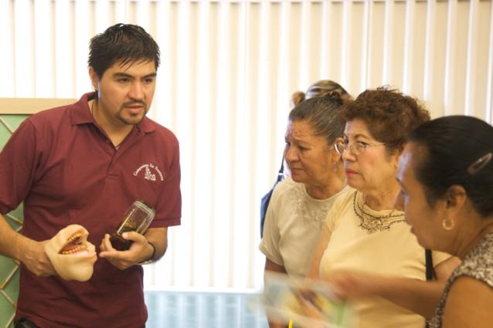
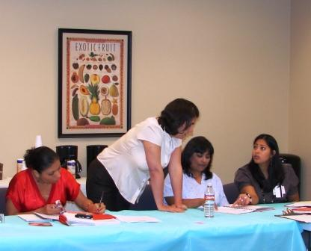
About NCFH
The National Center for Farmworker Health is a national, non-profit organization, located in Buda, Texas, dedicated to improving the health status of agricultural worker families through the provision of technical assistance, training and information services.
Promotor de Salud delivering oral health education at a health fair in Arizona
NCFH health educator training promotoras de salud

Slide 3
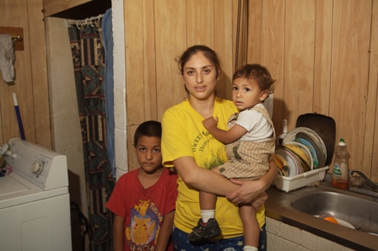
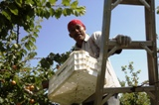
Purpose of Training
The NCFH has developed this training to prepare and empower migrant and seasonal agricultural workers to participate in the leadership and governance of health centers.
This training will provide participants the knowledge and skills to do this.

Slide 4
Training Learning Goals
During this training you will learn about:
Community leadership and the qualities of a good leader
Community health and why you should get involved
The history of migrant health and what services health centers provide
The leadership of a health center (the board of directors) and how it works, and why there is a need for agricultural worker representation
What it means to be a successful board member – duties, responsibilities and commitments
Next steps for becoming a board member of your local health center

Slide 5
Training Lessons
Lesson I: Participation and Leadership in Community Health
Lesson II: Understanding Health Center Leadership and Governance
Lesson III: Joining a Health Center Board of Directors

Slide 6
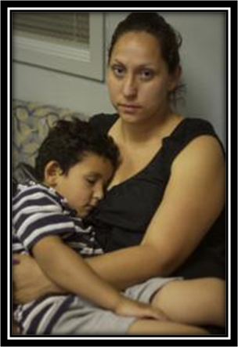
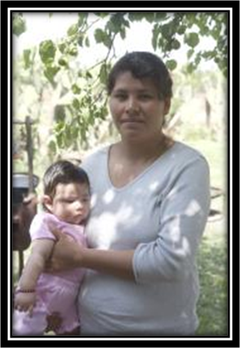
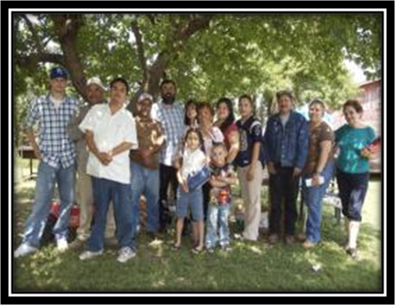
Lesson I: Participation and Leadership in Community Health

Slide 7
Lesson I: Learning Goals
By the end of this first lesson, you will be able to:
Explain what community participation and leadership mean to you
Identify types of leadership opportunities and key leadership qualities
Give examples of health issues in the Hispanic/Latino community and in the agricultural worker community
Recognize your role in improving community health
Describe how becoming involved with a health center makes you a community leader.

Slide 8
Defining Community
A community is simply a group of people that may share some things or ideas in common, such as:
Location, neighborhood
Ethnicity, race, language, nationality
Interests, activities
Beliefs, values
Role, title, job
Life experiences

Slide 9
What does “community” mean to you?
Tell us something about you…

Slide 10
What makes people in a community come together more?

Slide 11
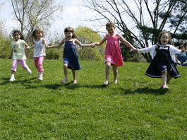
Identifying common needs, goals or shared values makes people in a community work more closely together to address these needs, goals or shared values.

Slide 12
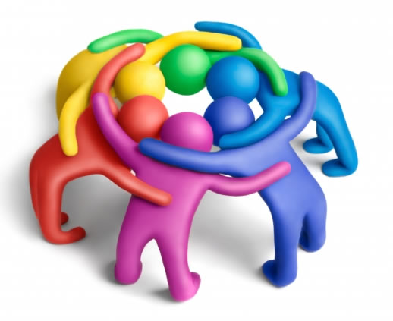
Community Participation
The involvement of all members is key to the development of a more successful community.
Participation means when:
When people see a need and they get organized and work together to address this need
When people voice their opinions and needs to the leadership of the community

Slide 13
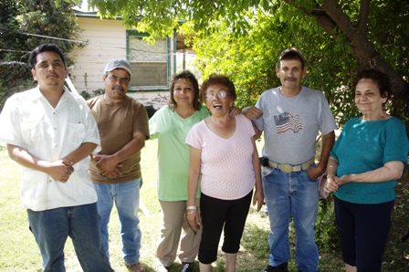
Key Point
Active participation from all members of a community has the power to make a community better and more successful for everybody in it. More can be achieved when community members join their efforts together.

Slide 14
What are some examples of community participation that you’ve seen or been a part of?
How did community participation help improve your community?
What are some of the reasons that made you get involved in these community activities?

Slide 15
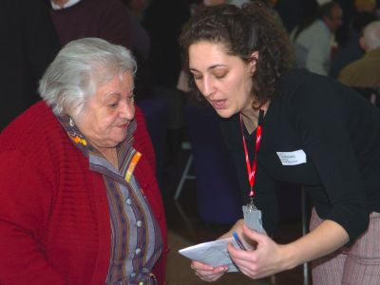
Examples of Community Participation
Volunteering
Volunteers freely give time, effort and talent to a need or cause in the community.

Slide 16
What are some of the organizations or projects that you have volunteered for?

Slide 17
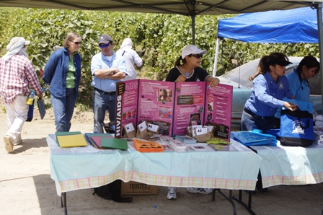
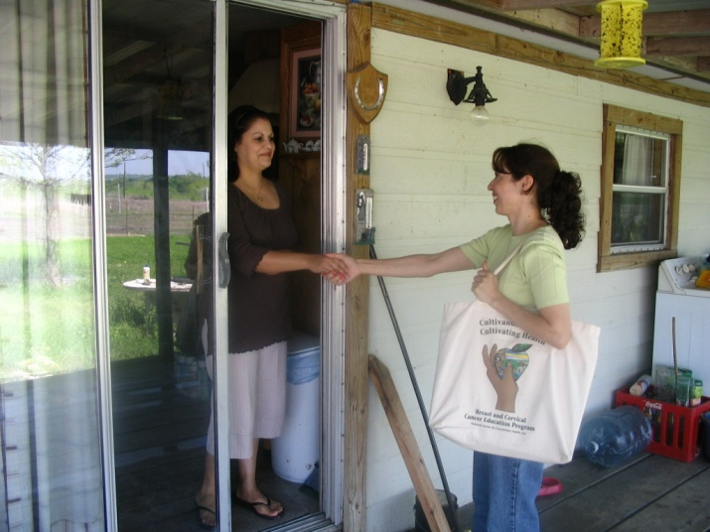
Volunteering
Places to volunteer:
Community organizations
Religious organizations
Public agencies
Community programs
Community events
Long terms vs. short term

Slide 18
How did the organizations or programs you volunteered for benefit from your volunteer work?
What did you gain from volunteering?

Slide 19
Benefits of Volunteering
Gives you the opportunity to change lives, including your own
Makes you feel needed
Leads to learning new skills
Helps you meet new people and may provide opportunities for future employment or other important connections

Slide 20
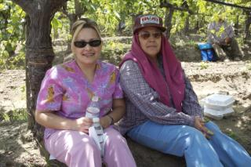
Examples of Community Participation
Mentoring
A mentor is someone who is trusted and respected that becomes deeply involved in another person’s life as a role-model, or to provide advice or guidance.

Slide 21
Can someone share an example of what a mentor does?

Slide 22
Have you ever had a mentor?
Have you been a mentor to someone else?
How did this relationship influence your life?
How did this relationship influence the other person’s life?

Slide 23
Benefits of Mentoring
A mentor can significantly influence someone else’s life in a positive way. This will have a positive result for the community as a whole as people make better and healthier choices in their lives.
Mentors may make a greater impact if they are mentoring emerging community leaders. As they provide guidance and leadership to future leaders, they are providing leadership to the community as a whole.
Mentoring also has personal benefits. It is a great way to increase your confidence, self-esteem, and it really gives you a sense of contributing to those around you.

Slide 24
Examples of Community Participation
Community Advocacy
Community advocacy is to speak on behalf of another person or a group to ensure that their rights and needs are recognized.

Slide 25
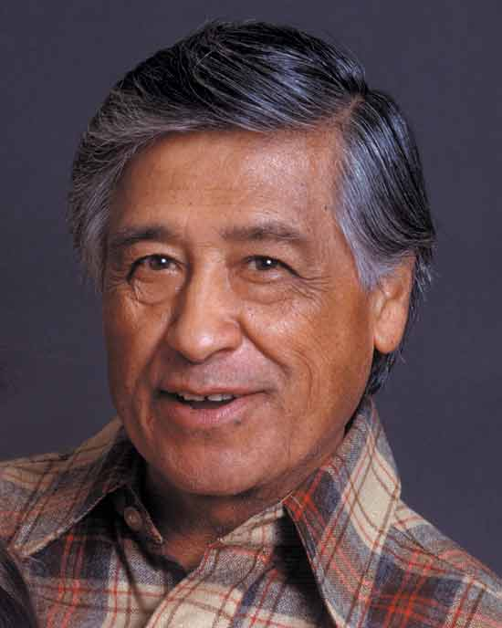
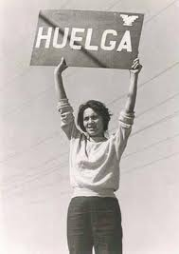
Can you name some famous community advocates throughout history?

Slide 26
What are some ways that people advocate for others?
How can advocacy lead to improvements for the whole community?

Slide 27
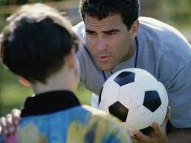
Community Advocacy Example
A Father as a Community Advocate

Slide 28
Other Community Advocacy Examples
Organizing a campaign to write letters to the government for community improvements
Hosting meetings with local leaders to discuss protection issues for agricultural workers
Bringing in representatives from organizations that provide important information for agricultural workers, about topics like health, education, legal rights, etc.

Slide 29
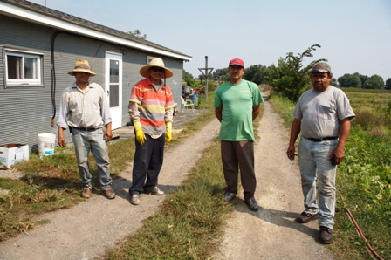
Key Point
There are many ways to become involved with your community. Community participation is essential to developing healthy and successful communities as a whole, but as we have seen, it also has important benefits for the individual.

Slide 30
Community Leadership
It is easy to see why people who participate actively in their community often become leaders of their communities.
Community leaders have the ability to change people’s behavior or opinions, bring people together for a common cause, and improve the services that the government and other organizations provide to their community.

Slide 31
What do you think of when you hear the word “leadership”?
What examples do you have of leaders in your community?
How are these people leaders in the community?

Slide 32
Community Leadership Example
Video clip: “La Voz Latina”

Slide 33
What kind of a difference did this “promotora” make in her community?
What are some of the qualities that you think made this “promotora” a leader?

Slide 34
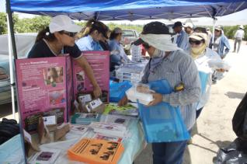
Key Point
You do not need a leadership title or position to have leadership qualities and be a community leader.

Slide 35
Leadership Qualities
Good leaders may have some of the following qualities:
They are honest
They are caring and understanding
They are passionate and inspire others to action
The have a vision for the future
They can plan and make changes happen

Slide 36
Can someone tell us about a leader you know that demonstrates any of these qualities?
What other qualities do you think are important?

Slide 37
Key Point
As you show leadership qualities, people are likely to follow you and look up to you regardless of your title or position, money or educational level.

Slide 38
Group Activity
Think about your community. Identify one thing that you would like to work on to make it better.
Talk with others in your group and list all of your ideas.
Select one thing from the list—you must agree as a group that this is the most important and first thing to start with.

Slide 39
Group Activity
Now imagine that you are looking for the best person in your community to lead this project.
What qualities or characteristics would you look for?
Talk with each other and list the ideas of everyone in the group

Slide 40
Group Activity
Pick a spokesperson to talk about what you have written down on your paper.

Slide 41
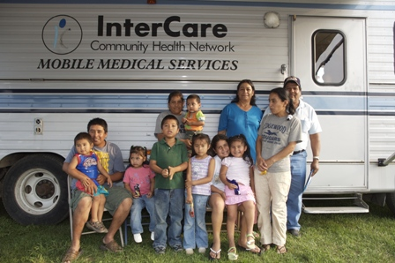
You Can Make a Difference !
As a community leader, you can guide the direction that your community goes in and make a big difference in the way things work in your community
One important issue you can get involved in is “community health”

Slide 42
Can someone tell us what we mean when we say “community health”?

Slide 43
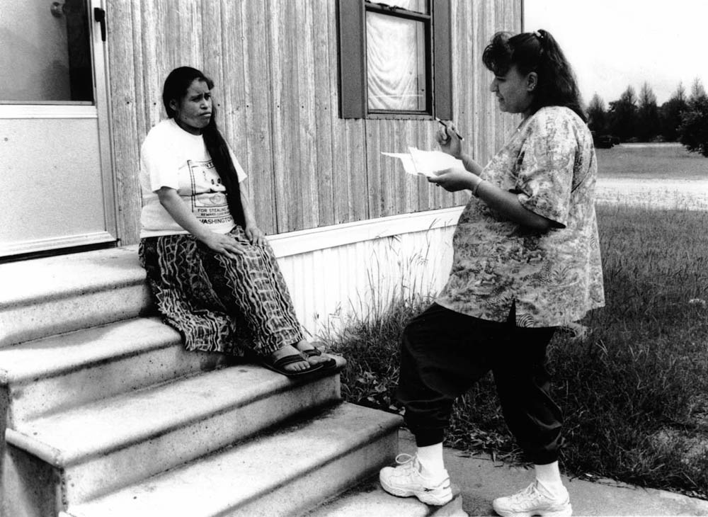
Defining Community Health
Community health refers to the “picture” of health of the entire community– what the health of that entire community looks like.

Slide 44
Why is it important to focus on community health?

Slide 45
Focusing on Community Health
Focusing on the overall health of a community is important because it helps health professionals know which practices and behaviors everyone should do to prevent disease and ensure that the community stays healthy.
Good community health information helps community leaders make better decisions about heath care resources needed, such as clinics, hospitals, specialists, and treatment and prevention programs (such promotora de salud programs).

Slide 46
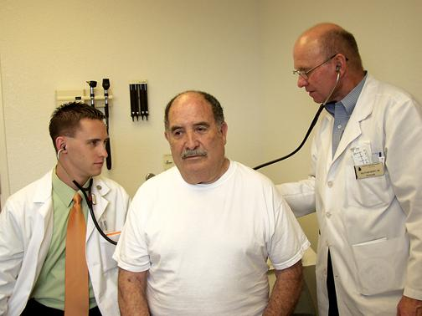
Hispanic/Latino Health
Leading Causes of Death for Hispanic/Latino Population in the United States, 2010
Cancer
Heart Disease
Unintentional Injuries
Stroke
Diabetes
Notes:
Source: National Vital Statistics Reports, Vol. 62, No. 6, December 20, 2013, Table 2, Page 55

Slide 47
How healthy do you think your community is?
Name some health issues that you see in your community.

Slide 48
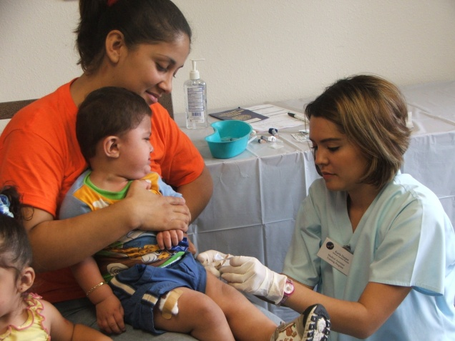
Hispanic/Latino Health
Other Top Health Issues Among Hispanic/Latinos:
Asthma
Obesity
Chagas Disease
HIV/AIDS
Teen Pregnancy
Smoking & Tobacco Use
Infant Mortality

Slide 49
Key Point
It is important to know about the health problems in your communities and what may be causing them, so that you can determine how to make changes towards a healthier community.

Slide 50
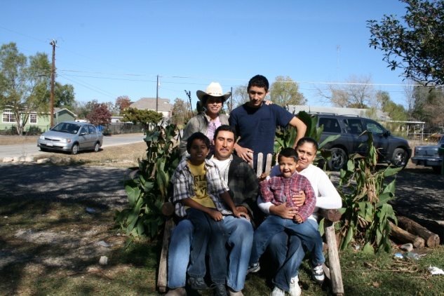
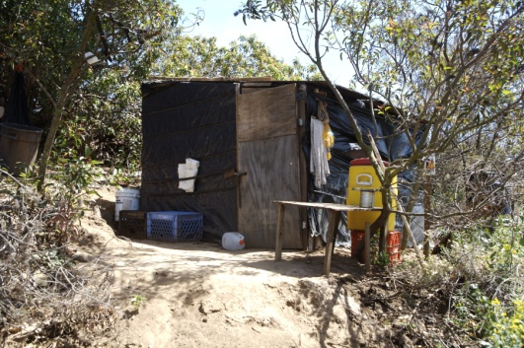
Conditions that Affect Community Health
Environmental
Socioeconomic
Lifestyle
Access to health services

Slide 51
Can anyone think of a condition or situation that may be leading to some health problems in your community?
Please share.

Slide 52
Community Health Involvement Example
Video clip:
“Creating an Urban Park in Santa Ana, CA”

Slide 53
What did you notice about community participation in this video?
What did you notice about leadership?
Who was a leader? What leadership qualities did these people have?

Slide 54
How many of you are currently agricultural workers?
How many have been agricultural workers at some point?
How many are family members of a agricultural worker?

Slide 55
Agricultural Worker Health
While agricultural workers share some of the health conditions and concerns we’ve discussed for the Hispanic/Latino population as a whole, agricultural workers have other unique health needs due to the difficult conditions of the work.
Often the frequency or intensity of a health problem is greater within the agricultural worker population than in the overall Hispanic/Latino population because of lack of access to care, extreme poverty and migratory nature of the work.

Slide 56
What are some of the unique conditions of the agricultural worker community that negatively affect agricultural worker health?
What are the greatest health problems you have seen in the agricultural worker community, or experienced yourself as an agricultural worker?

Slide 57
Unique Conditions Affecting Agricultural Worker Health
Low educational level and literacy
Poverty
Inadequate housing
Frequent mobility from one community to another
Lack of hygienic conditions, such as clean and potable water
Exposure to heat and sun
Dangerous machinery and equipment
Exposure to pesticides and pollution
Repeated and frequent body movements
Lack of sick benefits, such as time off to visit the doctor or health insurance

Slide 58
Common Health Problems among Agricultural Workers
Dehydration, heat stroke, and pesticide exposure
Malnutrition, anemia, and dental problems
Allergies, dermatitis, and insect bites
Musculoskeletal problems and arthritis
Gastro-intestinal and urinary tract infections
Chronic conditions: diabetes, hypertension, and tuberculosis
Depression and alcoholism

Slide 59
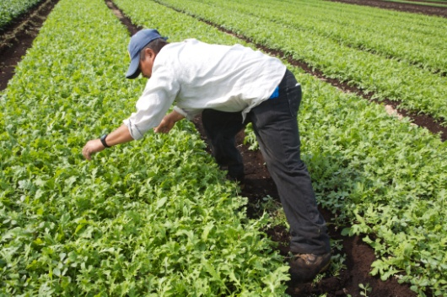
Barriers to Access Health Care
Lack of insurance
Lack of health care services near agricultural areas
Language and cultural barriers
Work schedule

Slide 60
What other barriers have you faced as an agricultural worker when trying to access health care?

Slide 61
What are some ways to address or eliminate some of these barriers to health care that agricultural workers face in your community?

Slide 62
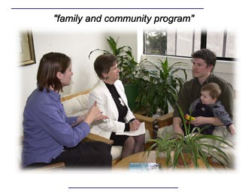
Key Point
One of the best ways to improve access to care for agricultural workers is to have good agricultural worker representation on the board of directors of your local health center.

Slide 63
Summary of Lesson I
Community participation gives you the power to make a positive difference for your community and for your family.
There are many ways to become involved in your community and through community participation you can become a community leader.
Leaders have some important qualities that make them leaders.

Slide 64
Summary of Lesson I
Community health is one area where your leadership and participation is needed, in particular for the Hispanic/Latino and the agricultural worker community.
There are many health needs in both of these communities, and there are barriers to access health care.
One of the best ways of becoming a leader in community health and an advocate for your community is to join your local health center’s board of directors. We will learn much more about how to do this in the next session.

Slide 65
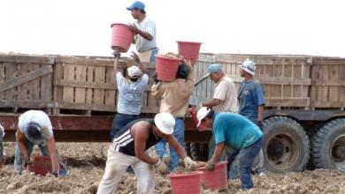
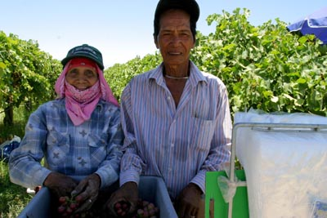
Key Point
By serving as a representative of the agricultural worker population on the board of directors of your local health center, you can be a community leader and ensure that agricultural workers can access the quality health care that they deserve.

Slide 66
Any questions or final comments?
THANK YOU FOR YOUR PARTICIPATION!

