Slide 1
Customizable Fact Sheet Template
The following fact sheet graphic templates are in PowerPoint format, allowing you to insert your own overlay copy, agency or organization’s logo, and preferred image(s).
Instructions for customizing the fact sheet template:
Replace any image:
1. Right-click the image you want to change.
2. Click Change Picture and then click This Device.
3. In the dialog box that opens, browse to the picture that you want to insert, click that picture, and then click Insert.
Insert your logo:
1. In the top toolbar, click Insert and then Pictures, then This Device.
2. In the dialog box that opens, browse to the logo that you want to insert, click that picture, and then click Insert.
Change the headline (or other text on the graphic):
1. Click on the text box that contains the text you want to change.
Tips:
• Keep headlines catchy and concise.
• Add a call-to-action.
• Focus on the target audience.
• Keep it positive.
Save a single slide as an image or PDF:
1. In the slide thumbnail pane, on the left side of the PowerPoint window, select the slide you want to save.
2. Click File > Save As (or Save a Copy if your presentation is saved on OneDrive or SharePoint). Navigate to the folder
where you want to save your slide.
3. Type the name of your slide image in the File name text box.
4. Click to open the Save as Type drop-down menu. Select one of the following image formats for your slide:
  • JPEG File Interchange Format (.JPG)
  • PNG Portable Network Graphics Format (.PNG)
  • PDF (.PDF)
5. Click Save. Review the PowerPoint dialog box and select Just This One to save your selected slide as an image or PDF.

Slide 2









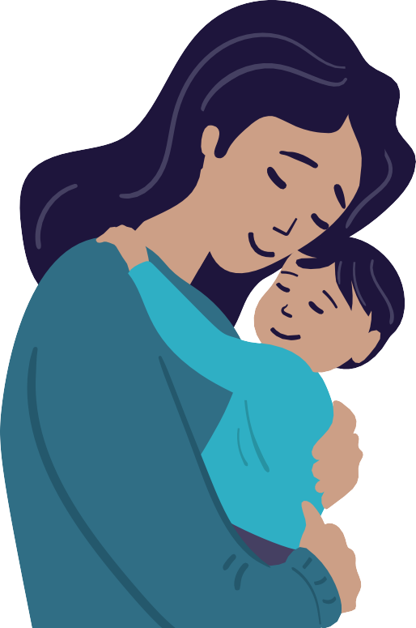
THERE’S A CURRENT OUTBREAK OF
MEASLES
Measles is a very contagious disease caused by a virus. It can be dangerous, especially for babies and young children. Protect your family and your community.
Measles spreads through the air when a sick person coughs or sneezes. The virus can stay in the air for 2 hours after a person with measles leaves the space. It is so contagious that about 9 out of 10 people who come near a person with measles and are not protected by vaccination will also become infected.
Measles symptoms appear 7 to 14 days after contact with the virus. Common measles symptoms include:
Measles can cause severe health problems, including:
High fever (may spike to more than 104°F) | Cough | Runny nose | Red and/or watery eyes | Rash (breaks out 3-5 days after symptoms begin) | Pneumonia | Swelling of the brain (encephalitis) | Possibly even death
The best way to protect against measles …
is with the measles, mumps, and rubella (MMR) vaccine. It’s never too late to get vaccinated. Vaccination helps protect you, the people around you, and your community. If you are not vaccinated, consider staying at home or away from crowded areas until measles cases in the area decrease, especially to protect people in your family that could get very sick.
If you think that you or someone in your family have measles, stay away from others and call a healthcare provider, urgent care, or emergency room.
Place logo here

