Slide 1
Customizable Fact Sheet Template
The following fact sheet graphic templates are in PowerPoint format, allowing you to insert your own overlay copy, agency or organization’s logo, and preferred image(s).
Instructions for customizing the fact sheet template:
Replace any image:
1. Right-click the image you want to change.
2. Click Change Picture and then click This Device.
3. In the dialog box that opens, browse to the picture that you want to insert, click that picture, and then click Insert.
Insert your logo:
1. In the top toolbar, click Insert and then Pictures, then This Device.
2. In the dialog box that opens, browse to the logo that you want to insert, click that picture, and then click Insert.
Change the headline (or other text on the graphic):
1. Click on the text box that contains the text you want to change.
Tips:
• Keep headlines catchy and concise.
• Add a call-to-action.
• Focus on the target audience.
• Keep it positive.
Save a single slide as an image or PDF:
1. In the slide thumbnail pane, on the left side of the PowerPoint window, select the slide you want to save.
2. Click File > Save As (or Save a Copy if your presentation is saved on OneDrive or SharePoint). Navigate to the folder
where you want to save your slide.
3. Type the name of your slide image in the File name text box.
4. Click to open the Save as Type drop-down menu. Select one of the following image formats for your slide:
  • JPEG File Interchange Format (.JPG)
  • PNG Portable Network Graphics Format (.PNG)
  • PDF (.PDF)
5. Click Save. Review the PowerPoint dialog box and select Just This One to save your selected slide as an image or PDF.

Slide 2
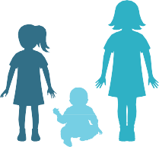







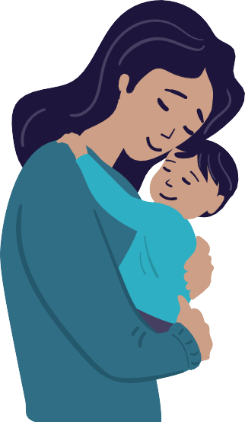
MEASLES
IT ISN’T JUST A LITTLE RASH
Measles can be dangerous, especially for babies and young children.
Measles symptoms typically include:
High fever (may spike to more than 104°F)
Cough
Runny nose
Red and/or watery eyes
Rash (breaks out 3-5 days after symptoms begin)
Measles can be serious.
Measles can cause severe health complications, including pneumonia, swelling of the brain (encephalitis) and death.
1 out of 5 people who get measles will be hospitalized.
1 out of every 20 children with measles will get pneumonia, the most common cause of death from measles in young children.
1 out of every 1,000 people with measles will develop brain swelling, which may lead to brain damage.
1 to 3 out of 1,000 people with measles will die.
Long-term complications A very rare, but deadly disease called subacute sclerosing
panencephalitis can develop 7 to 10 years after a person has recovered from measles.
You have the power to protect your child.
Provide your children with safe and
long-lasting protection against measles by making sure they get the measles-mumps- rubella (MMR) vaccine. Talk to your healthcare provider.
Place logo here

